Slide 1

Loop Statements
Alp KUT
Derya BİRANT
Kökten Ulaş BİRANT

Slide 2
OUTLINE
Loop Statements
  While - loop
  Do while - loop
  For - loop
Choosing a Loop
Examples

Slide 3
Introduction
Print the word “hello” ten times...
You could do it like this:
    Console.WriteLine("hello");
    Console.WriteLine("hello");
    Console.WriteLine("hello");
    Console.WriteLine("hello");
    Console.WriteLine("hello");
    Console.WriteLine("hello");
    Console.WriteLine("hello");
    Console.WriteLine("hello");
    Console.WriteLine("hello");
    Console.WriteLine("hello");
    What about if you want to print 100 times?

Slide 4
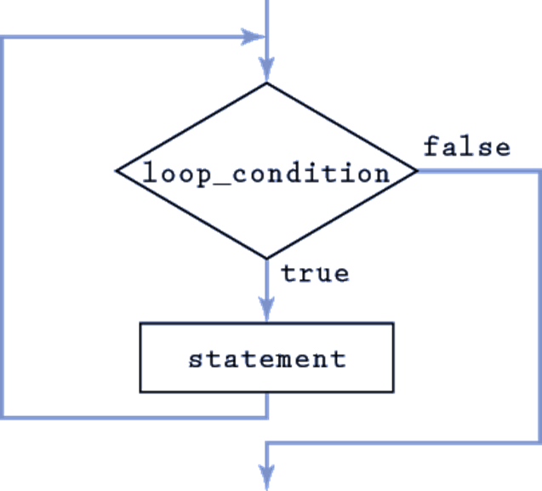
Loop Statements
Loops permit statement(s) to be executed repeatedly

Slide 5
Loop Example
Start
counter=1
Write counter
counter = counter +1
counter
!=100?
True
False
End

Slide 6
Loop Components
Control variable (loop counter)
Initial value of the control variable
Execute statement(s)
Increment/decrement of control variable through each loop
Loop-condition that tests for the final value of the control variable
counter = 1
statement
counter = counter +1
counter
!=100?
True
False

Slide 7
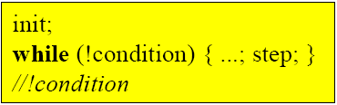
"while" Statement
Repeats an action while its loop-condition remains true
init
F
condition
T
statement
step

Slide 8
"while" Statement
Repetition continues so long as condition is true!
int i=1;
while (i <= 10)
{
Console.Write(" " + i);
i = i + 1;
}
Start
counter=1
Write counter
counter = counter +1
1 2 3 4 5 6 7 8 9 10
counter
<=10?
True
False
End

Slide 9
"while" Statement
int i=1;
while (i <= 10)
{
Console.Write(" " + i);
i = i + 2;
}
1 3 5 7 9

Slide 10
"while" Statement
Find the total of the numbers between 1 and 10
int i = 1;
int sum = 0;
while (i <= 10)
{
sum = sum + i;
i = i + 1;
}
Console.WriteLine(sum);
i | sum
1 | 0
1 | 1
2 | 3
3 | 6
4 | 10
5 | 15
6 | 21
7 | 28
8 | 36
9 | 45
10 | 55
11 | 55
55

Slide 11
"while" Statement
Find the total of given 5 numbers
int i=1;
int sum = 0;
int number;
while (i <= 5) {
number=Convert.ToInt16(Console.ReadLine());
sum = sum + number;
i = i + 1;
}
Console.WriteLine(sum);
i | number | sum
1 | ? | 0
1 | 14 | 14
2 | 3 | 17
3 | 9 | 26
4 | 6 | 32
5 | 2 | 34
6 | 2 | 34
34

Slide 12
"while" Statement
Write a program that finds the count of positive numbers within given 15 numbers.
int i=1;
int count = 0;
int number;
while (i <= 15)
{
number = Convert.ToInt16(Console.ReadLine());
if (number > 0)
count = count + 1;
i = i + 1;
}
Console.WriteLine(count);

Slide 13
"do while" Statement
while statement
  Performs the actions in its body zero or more times
do…while statement
  Performs the actions in its body one or more times
int i = 0;
while (i < 5) {
...
i++;
}
int i = 0;
do {
...
i++;
}
while (i < 5);
iteration with test at the begin of the loop
iteration with test at the end of the loop
(first pass always executed)

Slide 14
"do while" Statement
int i=1;
while (i <= 10)
{
Console.Write(" " + i);
i = i + 1;
}
1 2 3 4 5 6 7 8 9 10
int i=1;
do
{
Console.Write(" " + i);
i = i + 1;
} while (i <= 10);
1 2 3 4 5 6 7 8 9 10

Slide 15
"do while" Statement
int i=20;
while (i <= 10)
{
Console.Write(" " + i);
i = i + 1;
}
int i=20;
do
{
Console.WriteLine(" " + i);
i = i + 1;
} while (i <= 10);
20

Slide 16
"do while" Statement
Write a program that finds the count of even numbers within given 10 numbers
int i=1, count = 0, number;
do
{
number = Convert.ToInt16(Console.ReadLine());
if (number % 2 == 0)
count = count + 1;
i = i + 1;
} while (i <= 10);
Console.WriteLine(count);

Slide 17
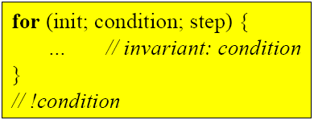
"for" Statement
for loop permits a statement to be executed repeatedly:
init
F
condition
T
statement
step

Slide 18
"for" Statement
The for loop is most commonly used to count from one value first to another value last:
for (int count = first; count <= last; count++)
Statement
count = first
F
count <= last
T
Statement
count++

Slide 19
"for" Statement
initial value of
i is 1
Condition tests for final value
Increment of i
for ( int i = 1; i <= 10; i++ )
Console.Write( " " + i );
1 2 3 4 5 6 7 8 9 10

Slide 20
"while" vs. "for" Statements
Find the total of the numbers between 1 and 10
int i = 1;
int sum = 0;
while (i <= 10)
{
sum = sum + i;
i = i + 1;
}
Console.WriteLine(sum);
int sum = 0;
for (int i = 1; i <= 10; i++)
sum = sum + i;
Console.WriteLine(sum);
55

Slide 21
Examples
Vary the control variable from 1 to 100 in increments of 1
  For (int i=1; i<=100; i++)
Vary the control variable from 100 to 1 in decrement by –1
  For (int i=100; i>=1; i=i-1)
Vary the control variable from 7 to 77 in increments of 7
  For (int i=7; i<=77; i=i+7)
Vary the control variable from 20 to 2 in decrement by –2
  For (int i=20; i>=2; i=i-2)

Slide 22
Question
Write a program that prints the following numbers with a loop.
3 7 11 15 19 23 27

Slide 23
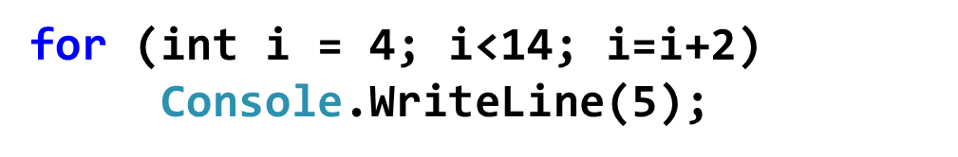
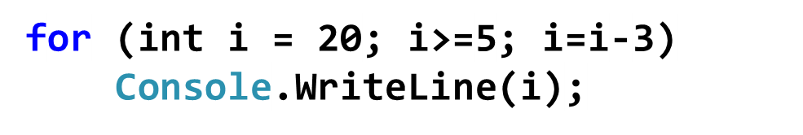
Question
What is the output of the following program?
What is the output of the following program?

Slide 24
"for" Statement
Find the total of the numbers between 1 and 5
int sum = 0;
for (int i = 1; i <= 5; i++)
sum = sum + i;
Console.WriteLine(sum);
i | Sum
1 | 1
2 | 3
3 | 6
4 | 10
5 | 15
15

Slide 25
Question
Write a program that takes 15 numbers from the user and prints they are even or odd.
Write a program that takes 15 numbers from the user and finds the count of even and odd numbers.
Write a program that takes 15 numbers from the user and finds the sum of even and odd numbers.

Slide 26
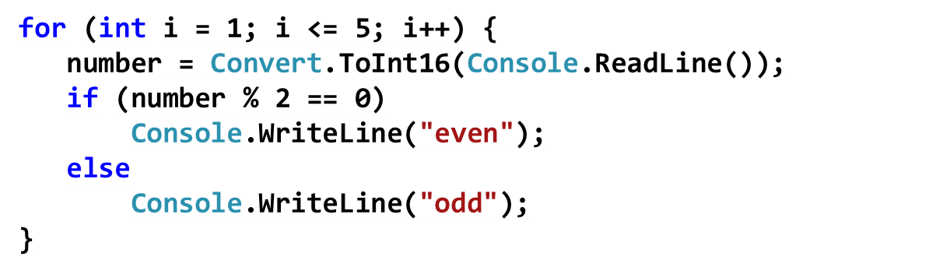
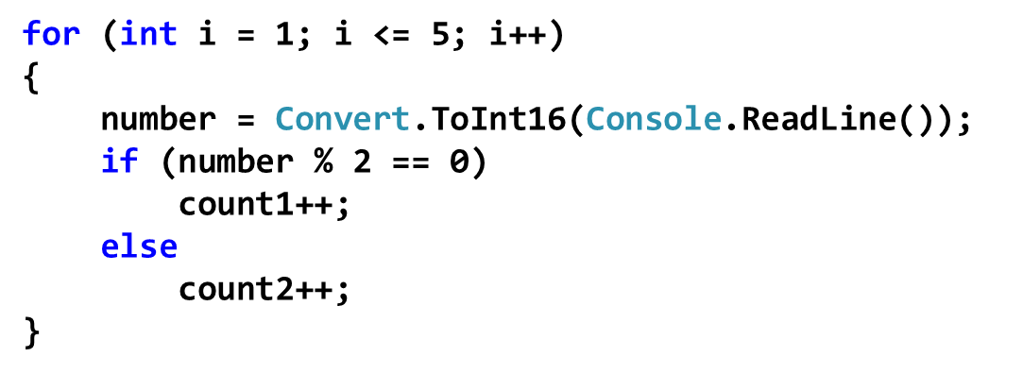
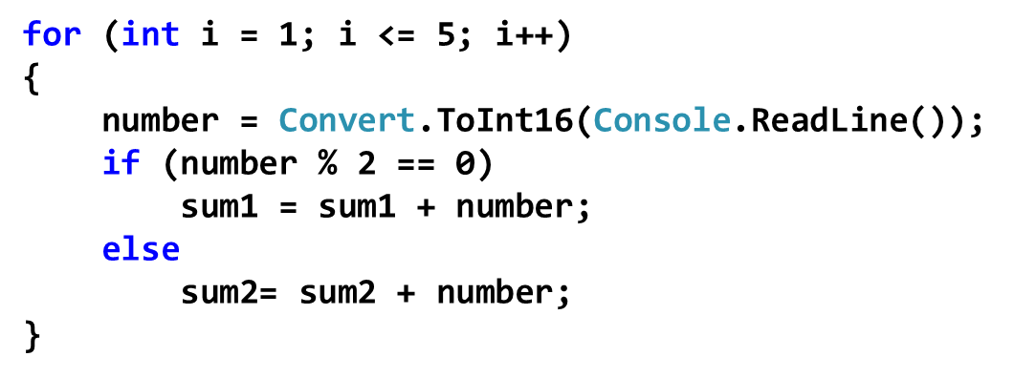

Slide 27
Example
Find the factorial of a given number
int n;
int facto = 1;
Console.WriteLine("Enter a number");
n = Convert.ToInt16(Console.ReadLine());
for (int i = 1; i <= n; i++)
facto = facto * i;
Console.WriteLine(facto);

Slide 28
Example
Write a program that calculates the result of x^{y}
int x=2, y=4, result = 1;
for (int i = 1; i <= y; i++)
result = result * x;
Console.WriteLine(result);

Slide 29
Example
A dice is rolled 18 times. Write a program that finds the count of each face of dice.
int bir=0, iki=0, uc=0, dort=0, bes=0, alti=0;
int face;
Random random = new Random();
for (int i = 1; i <= 18; i++)
{
face = random.Next(1, 7);
switch (face)
{
case 1:
bir = bir + 1;
break;
case 2:
iki = iki + 1;
break;
case 3:
uc = uc + 1;
break;
case 4:
dort = dort + 1;
break;
case 5:
bes = bes + 1;
break;
default:
alti = alti + 1;
break;
}
}
Console.WriteLine("bir = {0},
iki = {1}, uc = {2},dort = {3},bes = {4},altı = {5}“, bir, iki, uc, dort, bes, alti);

Slide 30
Summary
While – loop
  init; while (condition) { do something ; step}
Do while – loop
  init; do { something ; step } while (condition)
For – loop
  for (init; condition; step) { do something }

Slide 31
Choosing a Loop (for or while)
Which one to use?
Use the for loop for counting problems.
Use "while" for non-counting problems.

Slide 32
Choosing a Loop (for or while)
Find the average of given numbers until number is taken as -1
int number;
double sum = 0;
int count = 0;
Console.WriteLine("Enter a number");
number = Convert.ToInt16(Console.ReadLine());
while (number != -1)
{
sum = sum + number;
count = count + 1;
number = Convert.ToInt16(Console.ReadLine());
}
Console.WriteLine("The result = " + sum/count);

Slide 33
Choosing a Loop (for or while)
Write a program that finds the largest number within given 50 numbers.
int number;
int largest = -99999;
Console.WriteLine("Enter 50 numbers");
for (int i = 1; i <= 50; i++)
{
number = Convert.ToInt16(Console.ReadLine());
if (number > largest)
largest = number;
}
Console.WriteLine("The largest number is " + largest);

